Slide 1
Youtube Suggests

Slide 2
Introduction
What do you find as you type in any search box?
Search predictions that might be similar to the search terms you are typing.
What is this feature called?
This feature is called autocomplete or autosuggest which helps users to find relavant search terms related to their search terms.

Slide 3
Where they come from?
Google says that these suggestions are the searches which have been done by other people.
Suggestions can vary based on region and language too.
Suggestions can also contain the search terms you have previously searched for.

Slide 4
Benefits of autocomplete
Saving a few keystrokes thereby saving time.
Reduces errors in typing.
People can check the spelling the word which is hard to spell from suggestions .
Ideas on keywords to be given.

Slide 5
Where do autocomplete data actually come from?
Each time a site gets autocomplete data, your browser has to request it through the internet.
We can use this feature to check out the urls from which the autocomplete data is coming from.

Slide 6
See this in action
Go to wikipedia or google or youtube and type something in search bar.
Use your browser's developer tools to look at the network requests.

Slide 7
How to navigate to network requests in different browsers
Firefox: Tools > Developer > Network (refresh page to see)
Chrome: More Tools > Developer Tools > click Network
Safari: Develop > Show Web Inspector > click Timelines (refresh page to see)
Internet Explorer: press F12 key > click Network

Slide 8
How to access url
Now that network info is open, type something in the search bar
You will find that network requests are adding to the list of already existing requests(urls)
Open the url by copying and pasting in it in your browser’s address bar.

Slide 9
If you are using chrome and you type your query in search bar of youtube, the url would be something like: https://clients1.google.com/complete/search?client=youtube&hl=en&gl=in&gs_rn=23&gs_ri=youtube&tok=iizCYvSFKWok71NR4MrqYg&ds=yt&cp=9&gs_id=2b&q=slidenerd&callback=google.sbox.p50&gs_gbg=e9Voy4R174VeD65663P2ySz.

Slide 10
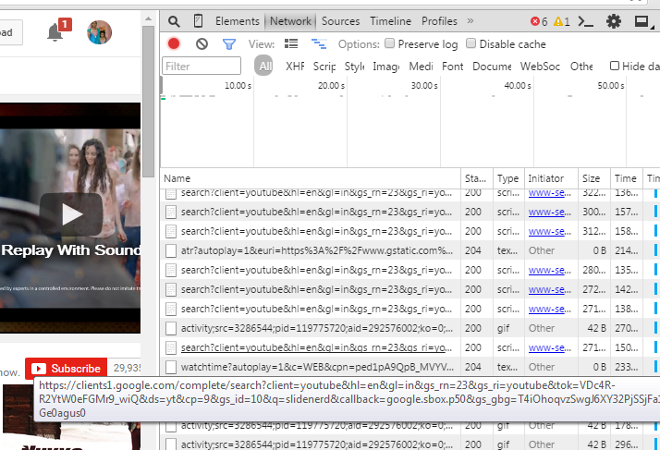
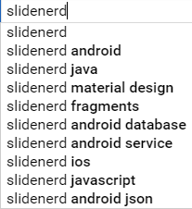

Slide 11
Accessing this url downloads a text file.
You can find the suggests related to your query.
With the suggests there is other data, which need to be removed if we want to extract only suggests.

Slide 12
How to extract only suggests?
You can easily do this with the knowledge of
Node js
String manipulation in javascript
After you get familiar with the above two, you will end up with your expected result i.e, only suggests.

Slide 13
What is node js?
Node js is an open source, cross-platform runtime environment for server-side and networking applications.
Node.js replaces the Java platform's standard, multithreaded approach with single-threaded, event-driven I/O

Slide 14
Request module
Acessing the url using node js?
- Using request module.
Request is designed to be the simplest way possible to make http calls.
This module can be installed after instaliing node js using the command
- npm install request.

Slide 15
How to use request module
var request = require('request');
request('http://www.google.com(your url)', function (error, response, body) {
if (!error && response.statusCode == 200) {
console.log(body) // Show the HTML for the Google homepage.
}
})

Slide 16
Arguments of request module
As the name implies, error contains information regarding any problems that occurred during the HTTP request.
The response argument is an object containing a variety of data returned from the call, including the status code, headers, and much more.
The third callback argument, body, is the body of the response.

Slide 17
The replace method
Usage
var str = “Hello World”;
var res = str.replace(“World”, “Everyone”);
We manipulate the body retrieved from the request accordingly so as to get the required format.

Slide 18
References
http://simplestepscode.com/autocomplete-data-tutorial/
https://github.com/ManasaGajulavarthy/Intern_HMIT

